Slide 1
Fog and Edge-Based Electricity Fault Detection System
Omkar Jakulwar
24196428

Slide 2
Introduction
This project focuses on building a real-time monitoring system for electrical pole sensors using an IoT-based architecture.
It collects live sensor data such as voltage, current, temperature, and pole tilt to detect faults in power distribution networks.
The system is designed using an edge, fog, and cloud architecture to process data efficiently and reduce cloud load.
AWS services like IoT Core, Lambda, SQS, SNS, API Gateway, Amazon ECR, and DynamoDB are used for secure communication, processing, and storage.
A React-based dashboard is developed to visualize live status, alerts, and historical data in real time.

Slide 3
Sensors used
Voltage (V) – Power supply detection
Current (A) – Load & overload monitoring
Temperature (°C) – Equipment overheating
Tilt (°) – Pole structural safety
Line Fault Indicator – Network faults
Power Status – System availability
Smart Meter (kW) – Energy consumption

Slide 4
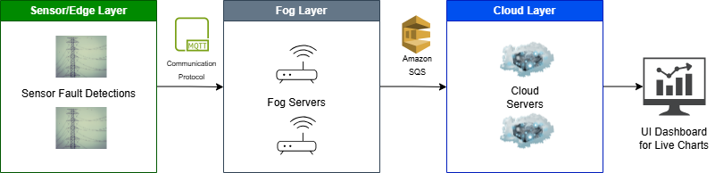
High level architecture

Slide 5
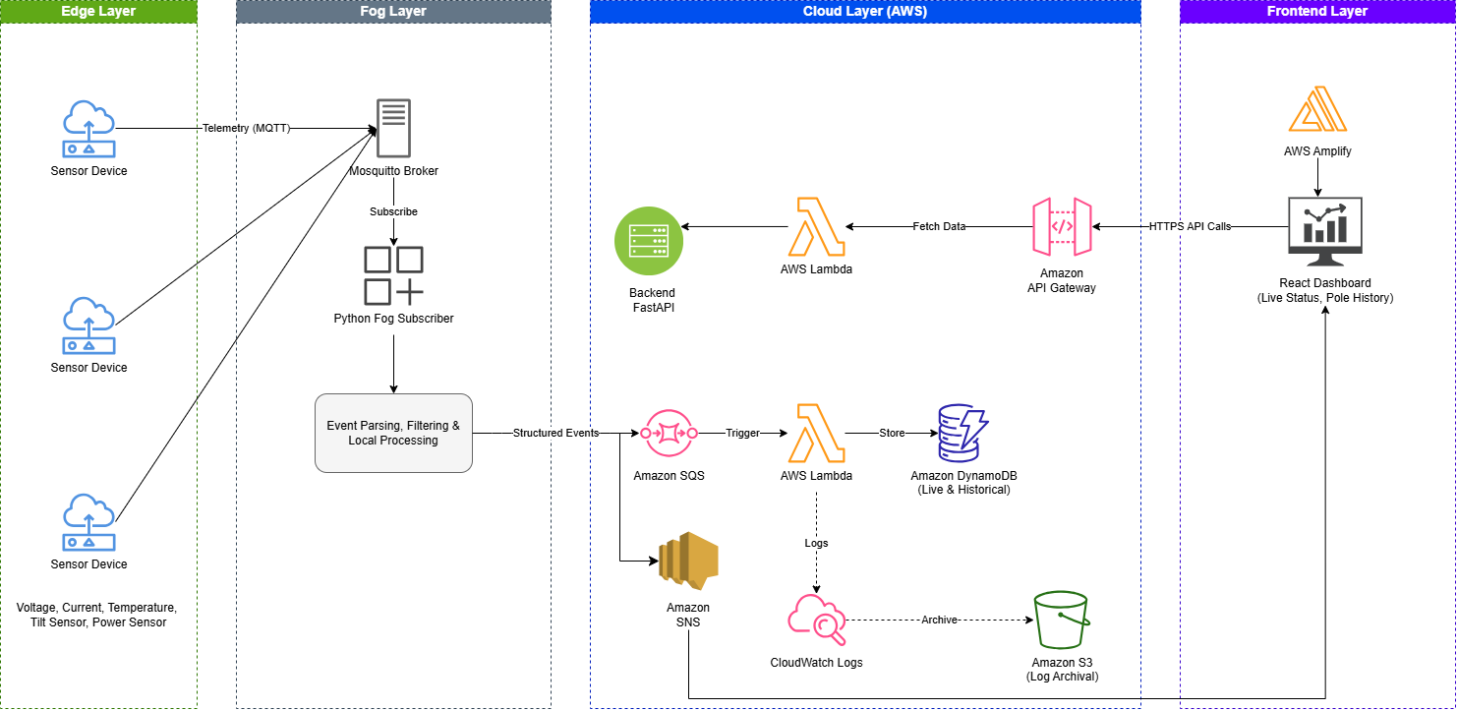
Architecture diagram

Slide 6
Functional requirements
The system should collect sensor data (voltage, current, tilt, temperature) from edge devices.
The system should publish and receive data using MQTT via a local Mosquitto broker.
The fog layer should process, filter, and transform raw sensor data into structured events.
The system should detect faults such as voltage drops, overload, overheating, and pole tilt issues.
The system should send processed events to the cloud using AWS IoT Core and Amazon SQS.
The cloud backend should store live and historical data in DynamoDB.
The system should provide REST API endpoints for accessing current status and historical data.
The frontend should display real-time updates and historical data through a dashboard.
The system should log events and errors for monitoring and debugging.

Slide 7
Live demo URL https://main.d24uw1llup1b1k.amplifyapp.com/

